Slide 1

Finite State Machines
Transducers
Chapter 5

Slide 2
Deterministic Finite State Transducers
A Moore machine M = (K, Σ, O, δ, D, s, A), where:
● K is a finite set of states
● Σ is an input alphabet
● O is an output alphabet
● s ∈ K is the initial state
● A ⊆ K is the set of accepting states,
● δ is the transition function from K × Σ to K,
● D is the output function from K to O*.
M outputs each time it lands in a state.
A Moore machine M computes a function f(w) iff, when it reads the input string w, its output sequence is f(w).

Slide 3
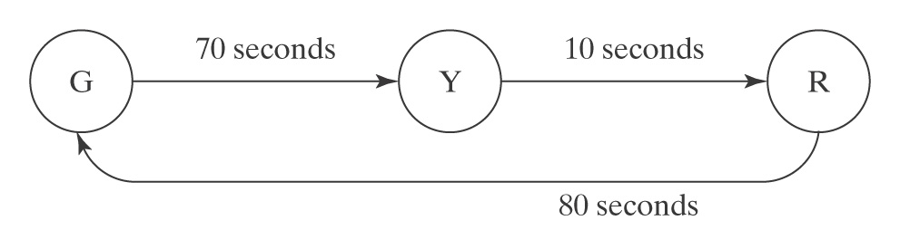
A Simple US Traffic Light Controller

Slide 4
Deterministic Finite State Transducers
A Mealy machine M = (K, Σ, O, δ, s, A), where:
● K is a finite set of states
● Σ is an input alphabet
● O is an output alphabet
● s ∈ K is the initial state
● A ⊆ K is the set of accepting states
● δ is the transition function from K × Σ to K × O*
M outputs each time it takes a transition.
A Mealy machine M computes a function f(w) iff, when it reads the input string w, its output sequence is f(w).

Slide 5
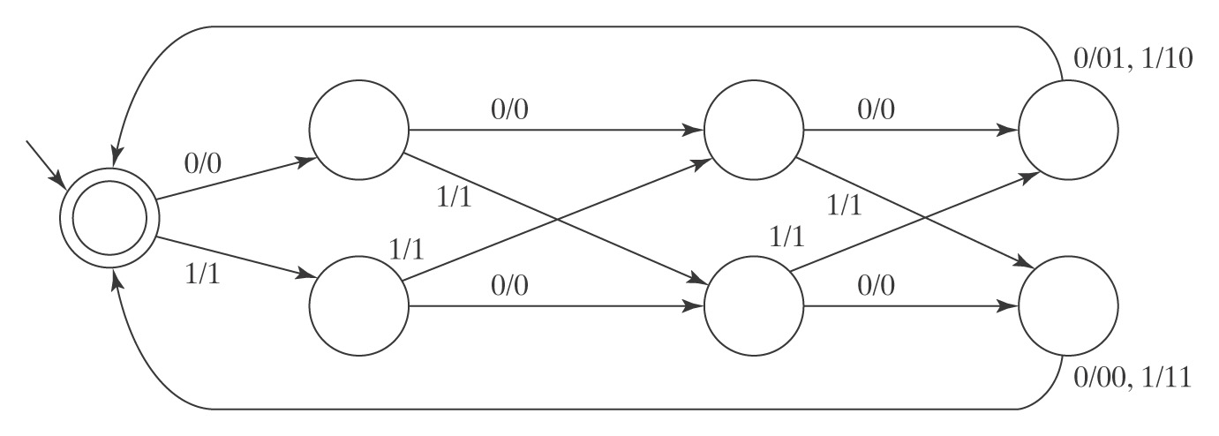
An Odd Parity Generator
After every four bits, output a fifth bit such that each group of four bits has odd parity.
0 0 1 0 1 1 0 0 0 0 0 0 1 1 1 1

Slide 6
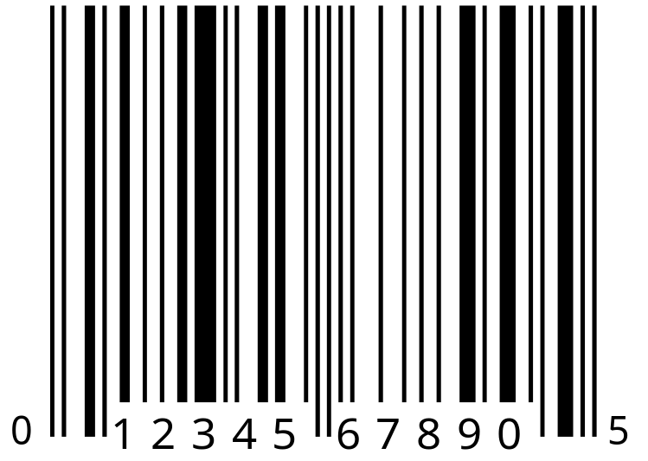
A Bar Code Scanner
Notes:
Single black line is a 0. Double black line is a 1.

Slide 7
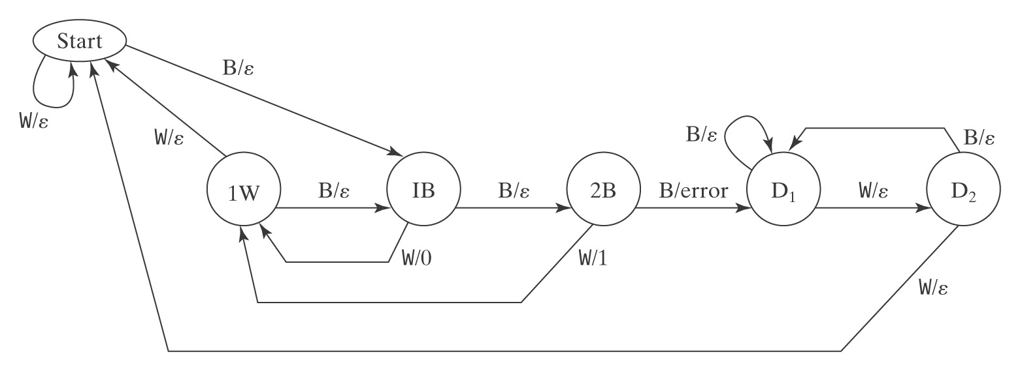
A Bar Code Scanner

Slide 8
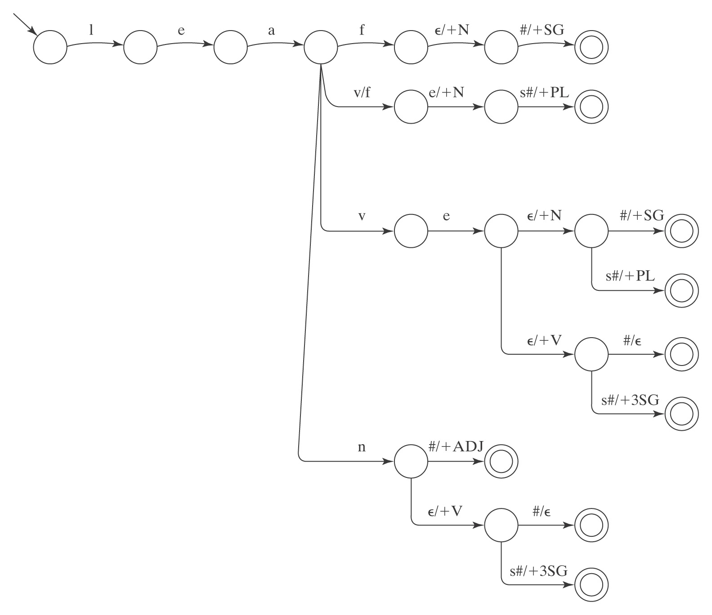
English Morphology

